Slide 1
Type casting

Slide 2
Induction to type casting
Type casting is when you assign a value of one primitive data type to another type.
In Java, there are two types of casting
Widening casting
Narrow casting

Slide 3
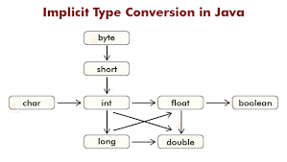
Widening casting

Slide 4
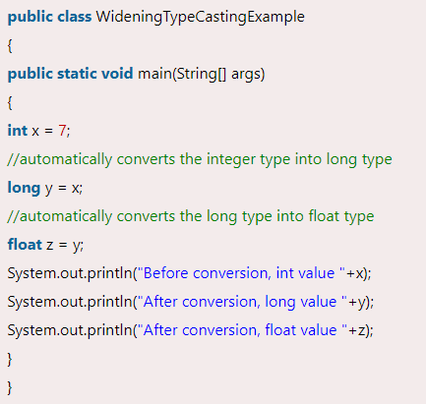
Example

Slide 5
Narrowing Casting
It must be done manually by placing the type in parentheses in front of the value.

Slide 6
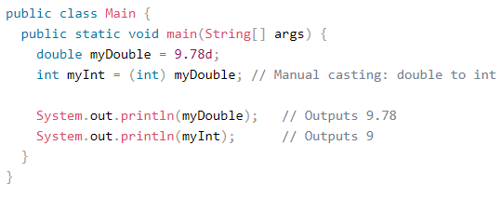
Examples

Slide 7
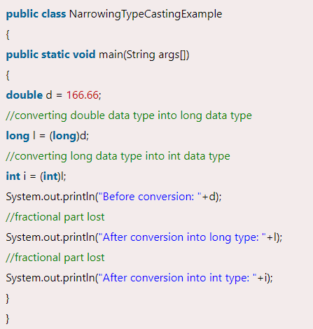
Example

Slide 8
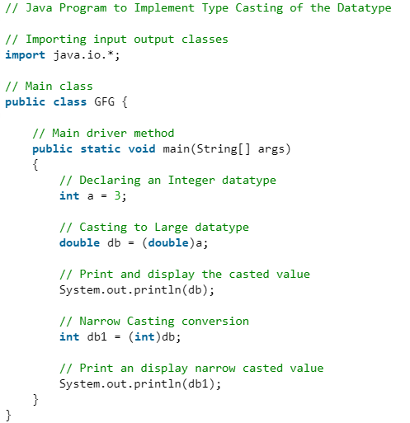
Example

Slide 9
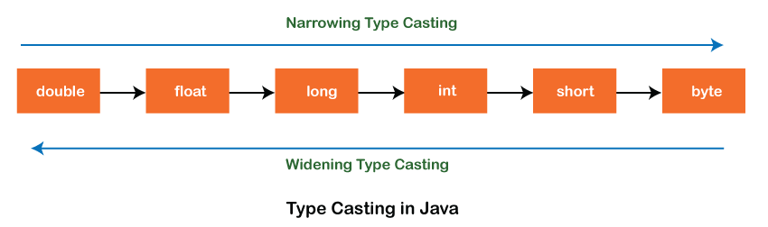

Slide 10

String
It is used to store text
It contains collection of characters surrounded by double quotes
String greeting= “Hello”;

Slide 11

Introduction
In Java, string is basically an object that represents sequence of char values.
Any array of characters works same as Java string
Java String class provides a lot of methods to perform operations on strings such as compare(), concat(), equals(), split(), length(), replace(), compareTo(), intern(), substring() etc.
Thus, string is a sequence of characters. But in Java, string is an object that represents a sequence of characters. The java.lang.String is used to create a string object.

Slide 12
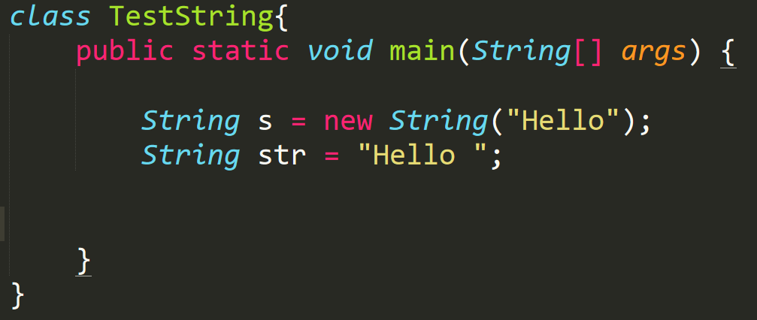
How to create a string object
There are two ways to create String object
By String literal
By new keyword

Slide 13
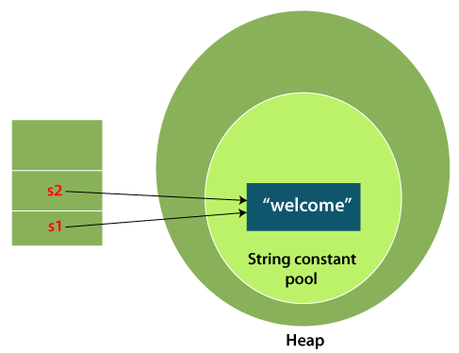
String literal
They are created by using double quotes.
Each time you create a string literal, the JVM checks the "string constant pool" first. If the string already exists in the pool, a reference to the pooled instance is returned. If the string doesn't exist in the pool, a new string instance is created and placed in the pool
In the above example, only one object will be created. Firstly, JVM will not find any string object with the value "Welcome" in string constant pool that is why it will create a new object. After that it will find the string with the value "Welcome" in the pool, it will not create a new object but will return the reference to the same instance.

Slide 14

Why Java uses the concept of String literal?
To make Java more memory efficient (because no new objects are created if it exists already in the string constant pool).

Slide 15
By new Keyword
In such case, JVM will create a new string object in normal (non-pool) heap memory, and the literal "Welcome" will be placed in the string constant pool. The variable s will refer to the object in a heap (non-pool).

Slide 16
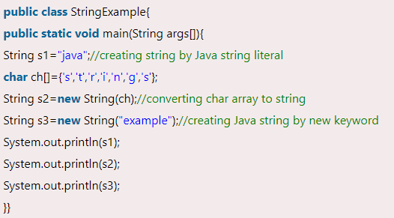
Example

Slide 17

Java String class methods
The java.lang.String class provides many useful methods to perform operations on sequence of char values.

Slide 18
Functions of String
String greeting = “Hello flocks”;
greeting.length()
greeting.toUpperCase()
greeting.toLowerCase()
greeting.indexOf(“o”);
greeting.lastIndexOf(‘o’)
greeting + “, Welcome “ or greeting.concat(“, Welcome”)

Slide 19
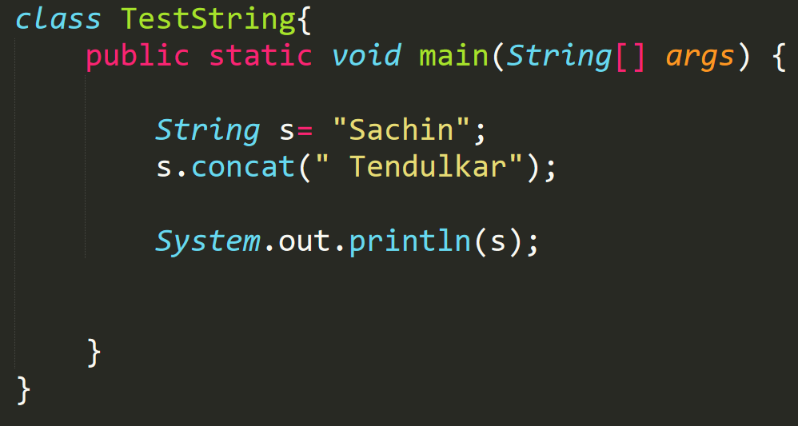
String Immutable in Java
A String is an unavoidable type of variable while writing any application program. String references are used to store various attributes like username, password etc.
In Java, String objects are immutable which simply means unmodifiable or unchangeable.

Slide 20
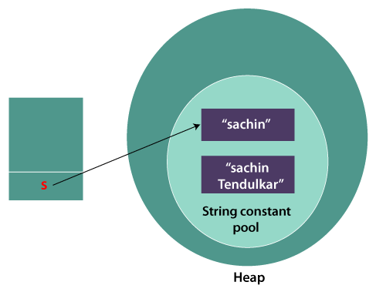
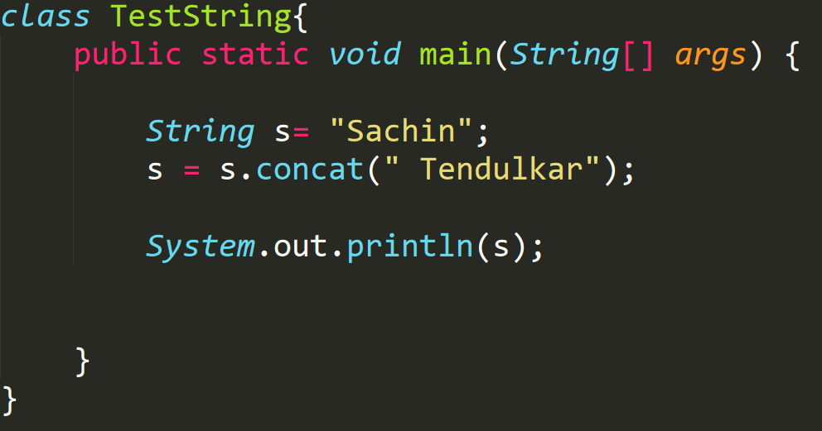
Continuous
As you can see in the above figure that two objects are created but s reference variable still refers to "Sachin" not to "Sachin Tendulkar".
But if we explicitly assign it to the reference variable, it will refer to "Sachin Tendulkar" object.
In such a case, s points to the "Sachin Tendulkar". Please notice that still Sachin object is not modified.

Slide 21
Why String Objects are immutable in Java?
As Java uses the concept of String literal. Suppose there are 5 reference variables, all refer to one object "Sachin".
If one reference variable changes the value of the object, it will be affected by all the reference variables. That is why String objects are immutable in Java.

Slide 22

Why String class is Final in Java?
The reason behind the String class being final is because no one can override the methods of the String class.
So that it can provide the same features to the new String objects as well as to the old ones.

Slide 23
Java String Compare
We can compare String in Java based on content and reference.
There are three ways to compare String in Java
By using equals() Method
By using == Operator
By compareTo() Method

Slide 24
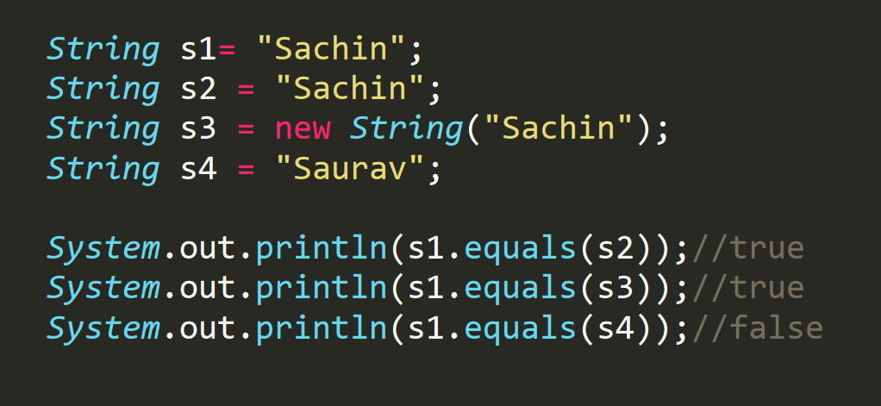
By Using Equals() method
The String class equals() method compares the original content of the string. It compares values of string for equality.
String class provides the following two methods.
public boolean equals (Object another )
public boolean eqaulsIgnoreCase(String another)

Slide 25
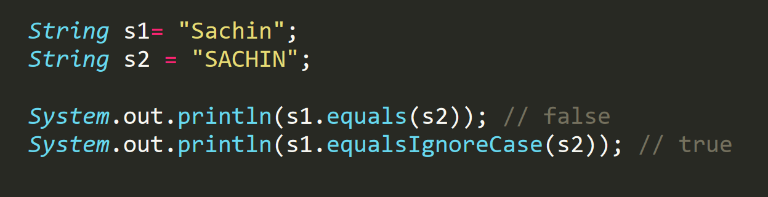
Continuous
In the above program, the methods of String class are used.
The equals() method returns true if String objects are matching and both strings are of same case. equalsIgnoreCase() returns true regardless of cases of strings.

Slide 26
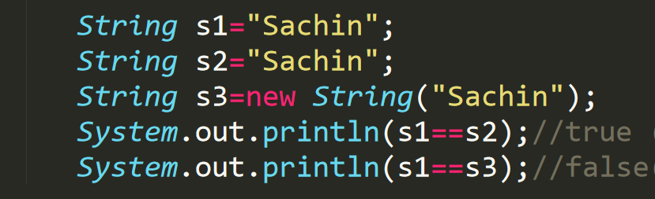
By using == operator
The == operator compares references not values.
The above code, demonstrates the use of == operator used for comparing two String objects.

Slide 27
By using compareTo() method
The String class compareTo() method compares values lexicographically and returns an integer value that describes if first string is less than, equal to or greater than second string.
Suppose s1 and s2 are two String objects. If:
s1 == s2 : The method returns 0.
s1 > s2 : The method returns a positive value.
s1 < s2 : The method returns a negative value.

Slide 28
Question 1
Write a program to illustrate that string literals are made in String constant pool, and they have same memory address if the content of the variable is same.

Slide 29
Question 2
Write a program to reverse a string.

Slide 30
Question 3
How to check Palindrome String in Java.

Slide 31
Question 4
Write a java program to capitalize each word first letter in string.

Slide 32
Question 5
Write a code to prove that strings are immutable in java?

Slide 33
Question 6
Java program to find the percentage of uppercase, lowercase, digits and special characters in String.
How to swap to string without using the third variable.
How to remove a particular character from a string.

Slide 34
Array in Java

Slide 35
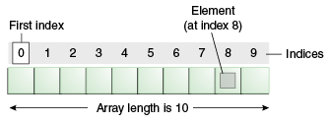
Introduction
An array is a container object that holds a fixed number of value of a single type in contiguous memory location.
The length of an array is determined at the time of array creation.
Array in java is index-based, the first element of the array is stored at the 0th index.
Unlike c/C++, we can get the length of the array using the length member whereas in C/C++ we use the sizeof operator.

Slide 36

Advantages
Code Optimization: it makes the code optimized, we can retrieve or sort the data efficiently
Random access : We can get any data located at an index position

Slide 37
Disadvantages
Size Limit: We can store only the fixed size of elements in the array. It doesn't grow its size at runtime. To solve this problem, collection framework is used in Java which grows automatically.

Slide 38
Creating an Array
Syntax to declare an array in Java
datatype[] arr
datatype []arr
datatype arr[]
Syntax to initialization of an array in Java
arrayRefVar = new datatype[];

Slide 39
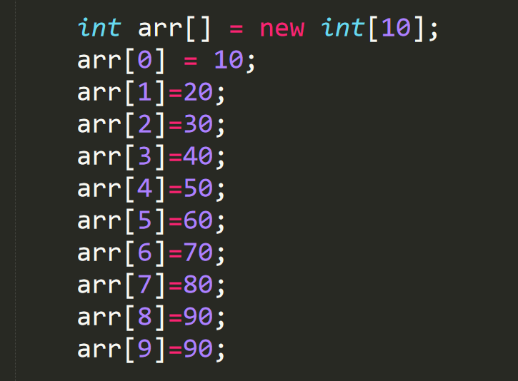
Example

Slide 40
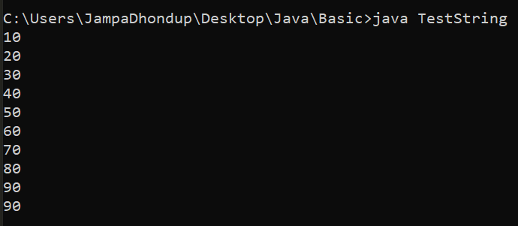
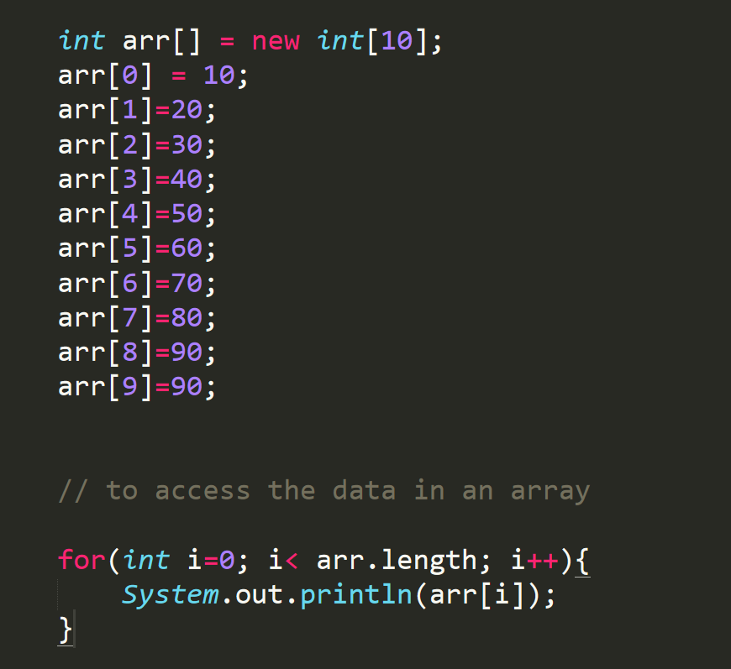
Looping the array in Java

Slide 41
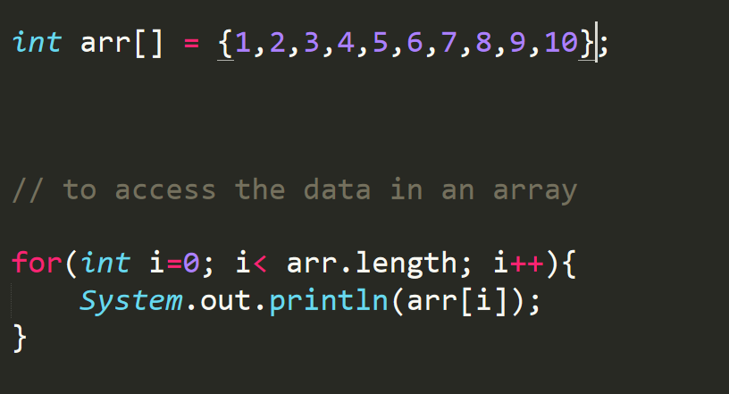

Slide 42
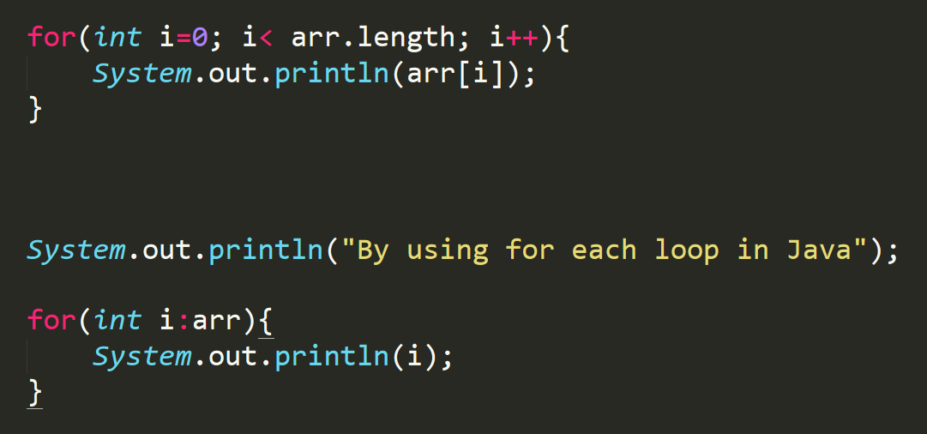
For each loop for Java Array

Slide 43
Copying the content of an array
They are two ways to clone an array in Java
By using the inbuilt method and clone the content of an array to another
By doing it programmatically

Slide 44
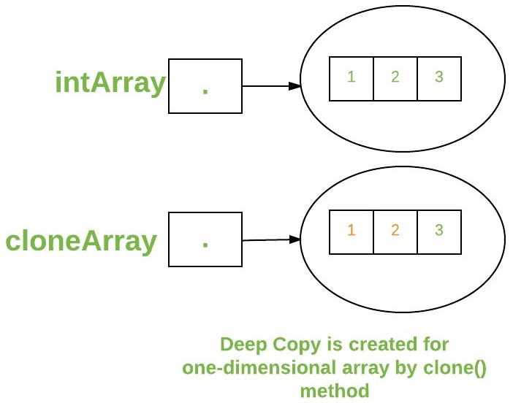
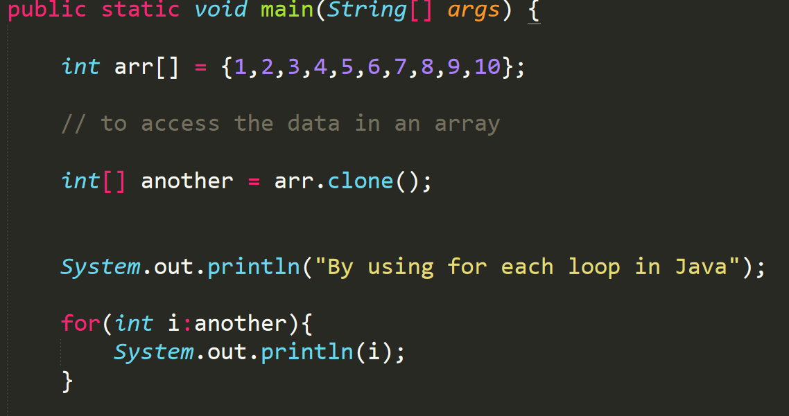
Inbuilt method to clone an array

Slide 45
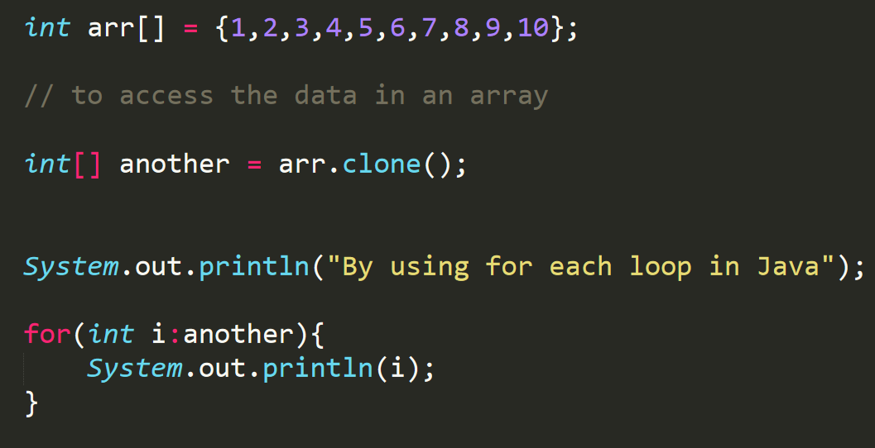

Slide 46
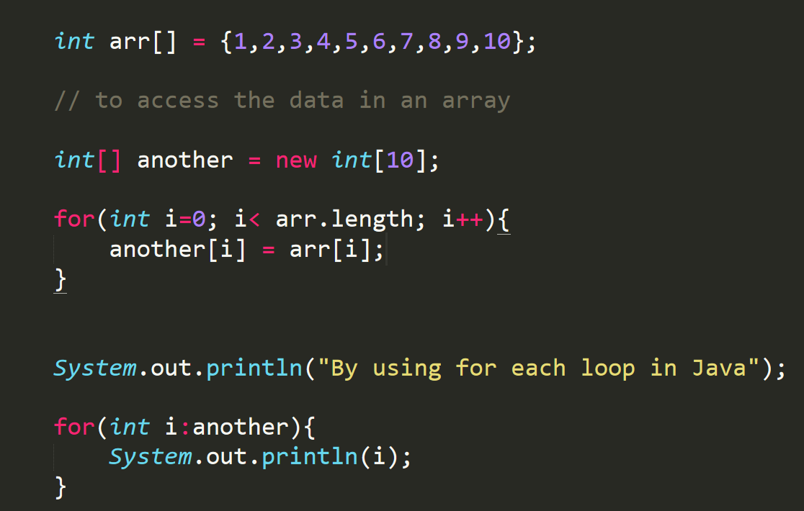
Clone programmatically

Slide 47
Array | Exercise one
Write a Java program to sum values of an array
Write a Java program to find the duplicate values of an array of integer values
Write a Java program to remove duplicate elements from an array.
Write a Java program to find the second largest element in an array.
Write a Java program to find the second smallest element in an array.
Write a Java program to add two matrices of the same size.

Slide 48
Array | Exercise Two
Write a Java program to calculate the average value of array elements.
Write a Java program to remove a specific element from an array.
Write a Java program to test if an array contains a specific value
Write a Java program to copy an array by iterating the array.
Write a Java program to find the maximum and minimum value of an array
Write a Java program to find the index of an array element.
Write a Java program to reverse an array of integer values.

Slide 49
Types of array in Java
They are two types of array
One Dimensional array
Multidimensional array

Slide 50
One Dimensional Array
What we have learnt so far is all about one dimensional array.
Now, we will discuss about the multi-dimensional array and jagged array

Slide 51
Multi-dimensional array
The data are stored in both row and column form thus, it is called the matrix form.
Syntax of declaring multidimensional array in java is
dataType[][] arrayRefVar; (or)
dataType [][]arrayRefVar; (or)
dataType arrayRefVar[][]; (or)
dataType []arrayRefVar[];
Multidimensional arrays can be defined in simple word as array of array.

Slide 52

Syntax of multidimensional array
data_type[1st dimension][2nd dimension][]..[Nth dimension] array_name = new data_type[size1][size2]….[sizeN];
Data_type : Type of data to be stored in the array. For example: int, char etc.
Dimension : the dimension of the array created
Array_name : Name of the array
Size1, size2…. sizeN : size of the dimension respectively

Slide 53

Size of multidimensional array
The total number of elements that can be stored in a multidimensional array can be calculated by multiplying the size of all the dimensions.
Example
The array int[][] x = new int[10][20] can store a total of (10*20) = 200 elements.
Similarly, array int[][][] x = new int[5][10][20] can store a total of (5*10*20) = 1000 elements.

Slide 54
Continuous
Instantiation of multidimensional array in java
int[][] arr=new int[3][3];//3 row and 3 column
Initialization of multidimensional array in java
arr[0][0]=1;
arr[0][1]=2;
arr[0][2]=3;
arr[1][0]=4;
arr[1][1]=5;
arr[1][2]=6;
arr[2][0]=7;
arr[2][1]=8;
arr[2][2]=9;

Slide 55
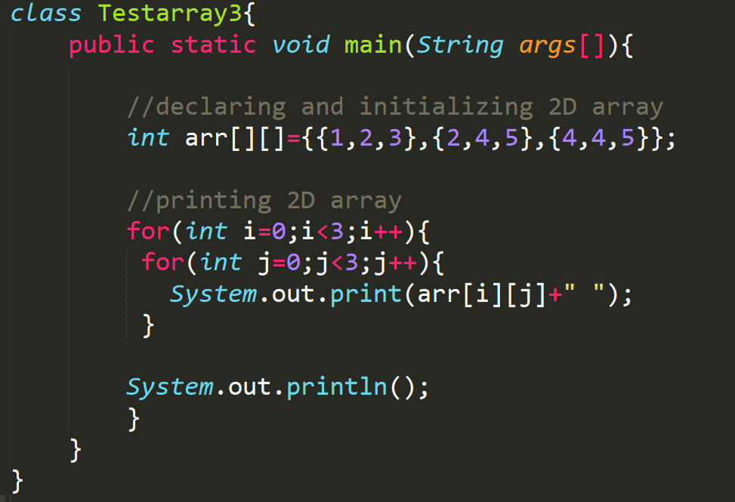
Example

Slide 56
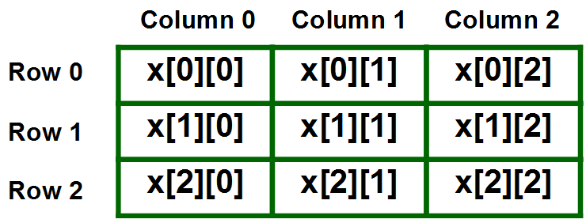
Representation of 2D array in Tabular Format
A two-dimensional array can be seen as a table with ‘x’ rows and ‘y’ columns number ranges from 0 to (x-1) and column number ranges from 0 to (y-1).

Slide 57
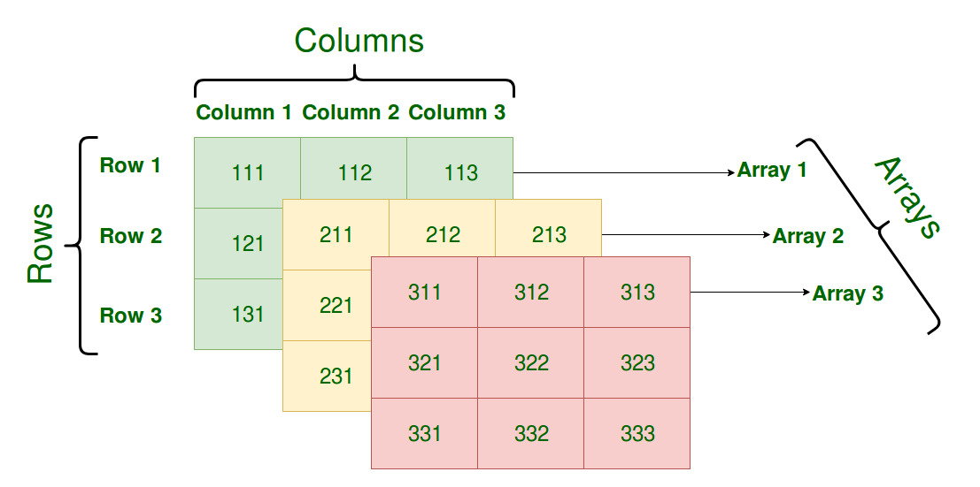
Representation of 3D array in Tabular format
A three – dimensional array can be seen as a tables of arrays with ‘x’ rows and ‘y’ columns where the row number ranges from 0 to (x-1) and column number ranges from 0 to (y-1). A three – dimensional array with 3 array containing 3 rows and 3 columns is shown below:

Slide 58
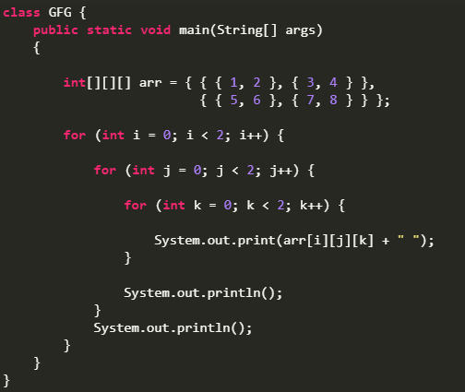
Print 3D array in tabular format

Slide 59
Java Math Class

Slide 60
Java User input ( Scanner )

Slide 61
To use Scanner class
First : we must import the java.util.Scanner Class from java.util package into our application.
Second : wherever we want to take an input, we must make an object of that class Scanner by taking an argument as System.in which represents the standard input stream.
To read numerical values of a certain data type XYZ, the function to use is nextXYZ().
To read strings, we use nextLine().

Slide 62
Java User Input
The Scanner class is used to get user input and it is found in the java.util package.
To use the Scanner class, create an object of the class and use any of the available methods found in the Scanner class documentation.
nextLine() method : which is used to read Strings
nextBoolean() method: reads a Boolean value from the user
nextDouble() method: reads double value from the user
nextInt() : reads a int value from the user
nextLong() : reads a long value from the user

Slide 63
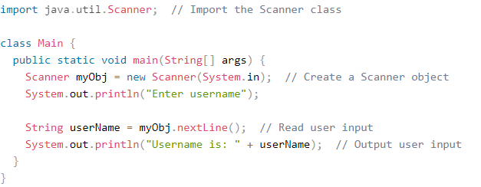
Example

Slide 64
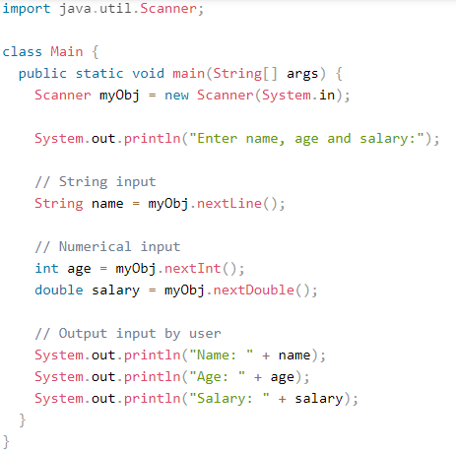
Example

Slide 65
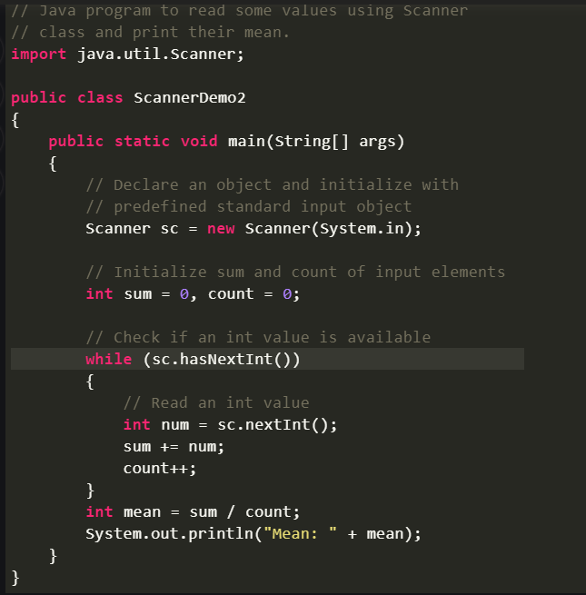
Example

Slide 66

Thank You !!

